Slide 1


Slide 2
Iclicker Question
What are the components of brand awareness?
Brand recognition
Brand recall
Brand familiarity
Both A and B
All of the above

Slide 3
Iclicker Question
Perceived quality and brand awanress are synonymous dimension of brand equity
True
False

Slide 4
Iclicker Question
To create differential responses that lead to Customer-based brand equity, marketers need to create brand associations that are
Strong
Favorable
Unique
Both A and B
All of the above

Slide 5
Iclicker
Brand associations can be
Tangible
Intangible
Both tangible and intangible

Slide 6
Brand Equity
CBBE
Brand Awareness
Brand Image/ Association
Perceived Quality
Brand Loyalty
Brand Awareness
Notes:
Perceived Quality: Signaling Theory
Brand Loyalty: Covers today.
This is a representation of the brand equity model, not the representation of the brand equity model. People can have Brand Awareness as the driver of Brand Image and Association, while perceived quality is just an image of the brand.
It’s more important that you think about these pre-requisite diemnsions or antecedents of brand equity in building a brand than having the exact “true” nature of the relationship. You can always have your own hypothesized model.

Slide 7

Chapter 3
Brand Resonance and the Brand Value Chain

Slide 8
Learning Objectives
Define
Define brand resonance
Describe
Describe the steps in building brand resonance
Define
Define the brand value chain
Identify
Identify the stages in the brand value chain

Slide 9
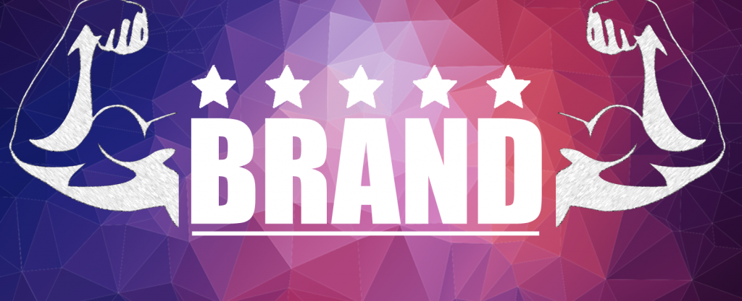
Building A Strong Brand: The Four Steps of Brand Building
Who are you? (brand identity)
What are you? (brand meaning)
What about you? What do I think or feel about you? ( brand responses)
What about you and me ? What kind of association and how much a connection would I like to have with you? (brand relationship)
Notes:
Brand knowledge
Building a strong brand: The four steps of brand building:
Ensure identification of the brand with customers
Firmly establish the totality of brand meaning in the minds of customers by strategically linking a host of tangible and intangible brand associations.
Elicit the proper customer responses to the brand.
Convert brand responses to create brand resonance and an intense, active loyalty relationship between customers and the brand.
To think about the inherent hierarchical structure of these steps, we will cover the branding ladder.

Slide 10
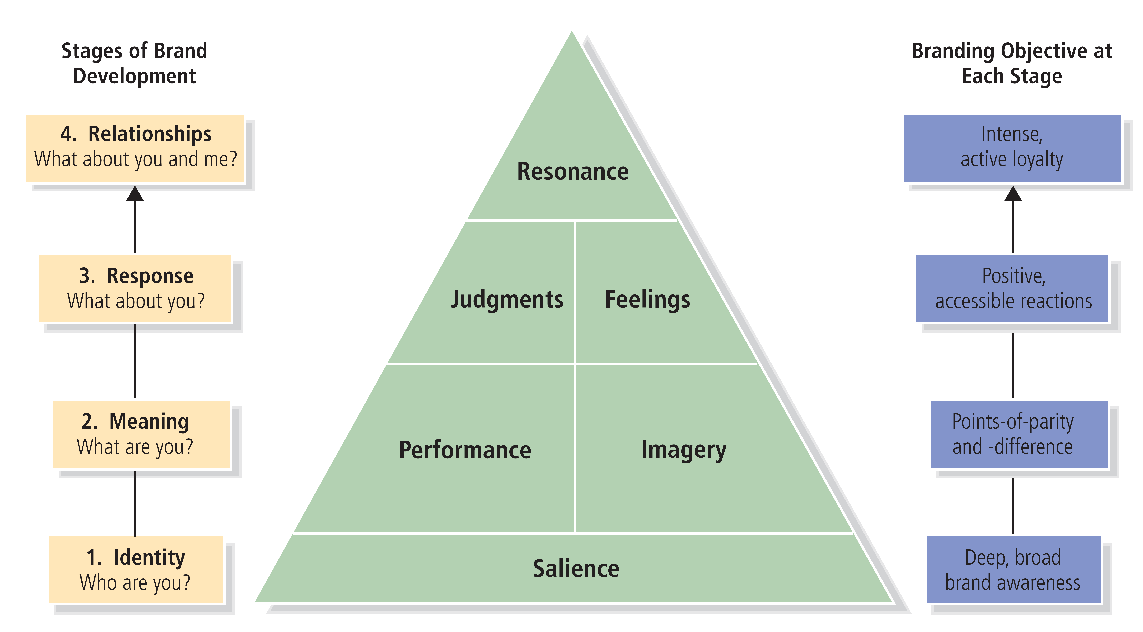
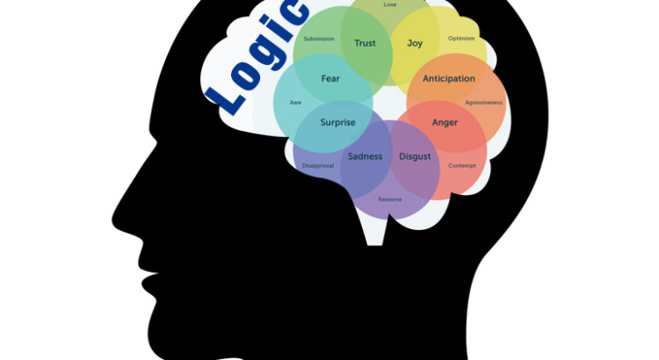

Figure 3-1: Brand Resonance Pyramid
Notes:
From identity to relationship.
2 different routes:
Rational
Emotional
Thinking Fast and Slow.
System 1 and System 2
Elaboration Likelihood Model: Central Route vs. Peripheral route processing. (Petty and Caioppo, 1980).
Daniel Kahneman
Prospect Theory (Kahneman and Tversky, 1979): losses loom larger than gains.

Slide 11
Figure 3-2: Subdimensions of Brand Building Blocks
Notes:
These are subdimensions of brand building blocks that

Slide 12
Brand Salience (1 of 3)
Achieving the right brand identity means creating brand salience with customers
Brand salience:
Measures various aspects of the awareness of the brand
How easily and often the brand is evoked under various situations or circumstances

Slide 13
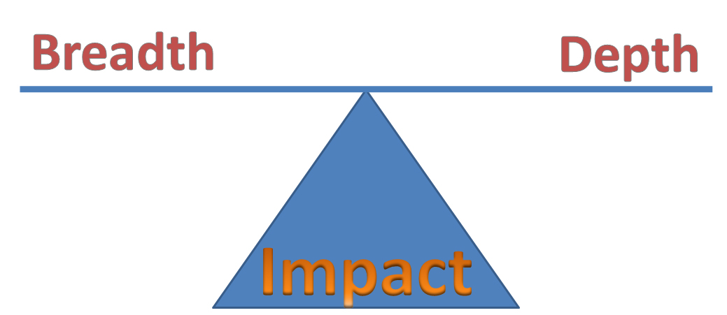
Brand Salience (2 of 3)
Breadth: The associated purchase
Depth: The consumption or usage situations
This Photo by Unknown Author is licensed under CC BY-NC
Notes:
Under brand salience, we have breadth and depth of awareness:
Breadth means the Range of purchase and usage situations in which the brand element comes to mind.
Depth is the Ease with which brand elements can be recalled.

Slide 14
Brand Salience (3 of 3)
Product category structure:
How product categories are organized in memory
Marketers assume that products are grouped
Notes:
We talked about product category in terms of breadth, in a consumer’s mind, there exists a product category structure, which is how product categories are organized in the consumer’s memory.
The beverage market provides a good setting to examine issues in category structure and the effects of brand awareness on brand equity. Figure 3-3 (on the next slide) illustrates one hierarchy that might exist in consumers’ minds.

Slide 15
Figure 3-3: Beverage Category Hierarchy
Notes:
Product category structure:
How product categories are organized in the consumer’s memory.

Slide 16
Brand Salience (4 of 4)
Strategic implications:
Brand needs to be top-of-mind and have sufficient mind share:
But also must do so at the right times and places
Notes:
Strategic implications:
Where do consumers think about a brand?
When consumers think of a brand?
How often do consumers think of a brand?

Slide 17
Brand Performance (1 of 2)
Describes how well the product or service:
Meets customers’ more functional needs
Rate on objective assessments of quality
Satisfies utilitarian, aesthetic, and economic customer needs and wants in the product or service category
Notes:
On the second rung left-hand side.

Slide 18
Brand Performance (2 of 2)
Attributes and benefits often underlie brand performance:
Primary ingredients and supplementary features
Product liability, durability, and serviceability
Service effectiveness, efficiency, and empathy
Style and design
Price
Notes:
Attributes and benefits that underlie brand performance:
Primary ingredients and supplementary features (Chick-fil-a sauce, KFC ingredients, iPhone touch screen).
Product reliability, durability, and serviceability:
Reliability: Measures the consistency of performance over time and from purchase to purchase.
Durability: The expected economic life of the product.
Serviceability: The ease of repairing the product if needed.
Service effectiveness, efficiency, and empathy:
Effectiveness: Measures how well the brand satisfies customers’ service requirements.
Efficiency: Describes the speed and responsiveness of service.
Empathy: Is the extent to which service providers are seen as trusting, caring, and having the customer’s interests in mind.
Style and design (e.g., Size, shape, materials, color – sensory aspect, look, feel, sound, smell)
Price:
Consumers may organize their product category knowledge in terms of the price tiers of different brands (relative expensiveness).

Slide 19
Brand Imagery (1 of 5)
Brand imagery depends on the extrinsic properties of a product or service
Many kinds of intangibles can be linked to a brand
Intangibles can be form
Directly: experience
Indirectly: WOM, reviews
Four main intangibles are:
User profiles
Purchase and usage situations
Personality and values
History, heritage, and user experiences
Notes:
The question associated with brand meaning is what are you? So we cover “what are you” in terms of brand performance, now we go on to cover brand imagery, the psychological counterpart of brand performance.
And we will go into detail for each of the intangible.

Slide 20
Brand Imagery (2 of 5)
User imagery:
Type of person or organization who uses the brand
Results of
Actual users
Aspirational or idealized users
Demographic factors:
Gender
Age
Race
Income
Psychographic factors:
Attitudes toward life
Social issues
Organizational factors (B2B):
Size
Type
Notes:
User imagery:
Type of person or organization who uses the brand.
Results in customers’ mental image of actual users or more aspirational, idealized users.
What are
Consumers may base associations of a typical or idealized brand user on descriptive demographic factors or more abstract psychographic factors:
Demographic factors: Gender (question Gillette, Axe – masculine), age (e.g., Pepsi is younger than Coke), race (e.g., Goya for Hispanic food), and income (e.g., BMW).
Psychographic factors: Attitudes toward life, careers, possessions, social issues, or political institutions.
Microsoft: bigger firm, salesforce: all type of firm (smaller).

Slide 21
Brand Imagery (3 of 5)
Purchase and usage imagery:
Associations that tells consumers under what conditions or situations they can or should buy and use a brand
Type of channel (department stores, specialty stores, online)
Specific stores (Macy’s, Foot Locker, Nordstrom)
Associations to a typical usage situation
Time of day, week, month, year
Location (e.g., inside or outside the home)
Type of activity during which to use the brand (formal vs. informal)
Notes:
Purchase and usage situations/imagery:
Associations that tell consumers under what conditions or situations they can or should buy and use the brand.
Associations to a typical usage situation can relate to the time to use the brand, location, and type of activity during which to use the brand.
Domino (delivery), Little Caesar (takeout), Pizza Hut (dine-in)

Slide 22
Brand Imagery (4 of 5)
Brand personality and values:
Through consumer experience or marketing activities, brands may take on personality traits or human values:
A person
Appear to be modern or old-fashioned
Five dimensions of brand personality (Aaker, 1997):
Sincerity
Excitement
Competence
Sophistication
Ruggedness
Notes:
Brand personality and values:
Through consumer experience or marketing activities, brands may take on personality traits.
Five dimensions of brand personality:
Sincerity (down-to-earth, honest, wholesome, and cheerful)
Excitement (daring, spirited, imaginative, and up-to-date)
Competence (reliable, intelligent, and successful)
Sophistication (upper class and charming)
Ruggedness (outdoorsy and tough)

Slide 23
Competence Vs. Warmth
Competence
Change perception
Warmth
Notes:
Halkias, G., & Diamantopoulos, A. (2020). Universal dimensions of individuals' perception: Revisiting the operationalization of warmth and competence with a mixed-method approach. International Journal of Research in Marketing, 37(4), 714-736.
Non-profit org credibly endorsed by the Wall Street Journal.

Slide 24

Brand Imagery (5 of 5)
Brand history, heritage, and experiences:
Brands may take on associations to their past
Certain noteworthy events in the brand’s history
Notes:
Brand history, heritage, and experiences:
Brands association with its past and with certain noteworthy events in the brand’s history.
These types of associations may recall distinctly personal experiences and episodes or past behaviors and experiences of friends, family, or others.
They can be highly personal and individual, or more well-known and shared by many people.
Examples where brands leverage their past to bolster their image.
Northern Trust used its 130 years of experience to reinforce trust and stability to its clientele.

Slide 25
Figure 3-1: Brand Resonance Pyramid
Notes:
They are interrelated performance and imagery concepts

Slide 26
Brand Judgments (1 of 4)
Customers’ personal opinions about and evaluations of a brand:
Quality
Credibility
Performance
Judgement
Consideration
Imagery
Superiority
Notes:
Consumers form judgments by putting together all the different brand performance and imagery associations
Customers make all types of judgments concerning a brand, but 4 important types are
Quality
Credibility
Consideration
Superiority

Slide 27
Brand Judgments (2 of 4)
Brand quality:
Defined by specific attributes and benefits of a brand
Consumers can hold a host of attitudes toward a brand:
But the most important relate to its perceived quality
Perceived quality measures are inherent in many approaches to brand equity
Notes:
Brand quality:
Specific attributes and benefits of the brand that help develop consumer attitudes toward the brand.
Important consumer attitudes relate to its perceived quality and to customer value and satisfaction.
Perceived quality measures are inherent in many approaches to brand equity.

Slide 28
Brand Judgments (3 of 4)
Brand credibility:
Judgments about the company or organization behind the brand, often defined by:
Perceived expertise
Trustworthiness
Likability
Notes:
Brand credibility:
Extent to which customers see the brand as credible in terms of perceived:
Expertise—Competence, innovation, and ability to lead.
Trustworthiness—Dependability and keeping customer interests in mind.
Likability—Fun, interesting, and worth spending time with.

Slide 29
Brand Judgments (4 of 4)
Brand considerations:
Unless a consumer gives serious consideration to purchase, how highly they regard the brand is of little importance
Depends on the extent to which strong and favorable brand associations can be created
Brand superiority:
Measures extent to which customers view the brand as unique:
And better than other brands
Notes:
Brand consideration:
How personally relevant customers find the brand.
Crucial filter in terms of building brand equity.
Threshold metaphor
Brand superiority:
Extent to which customers view the brand as unique and better than other brands.
Critical to building intense and active relationships with customers.
Depends to a great degree on the number and nature of unique brand associations that make up the brand image.

Slide 30
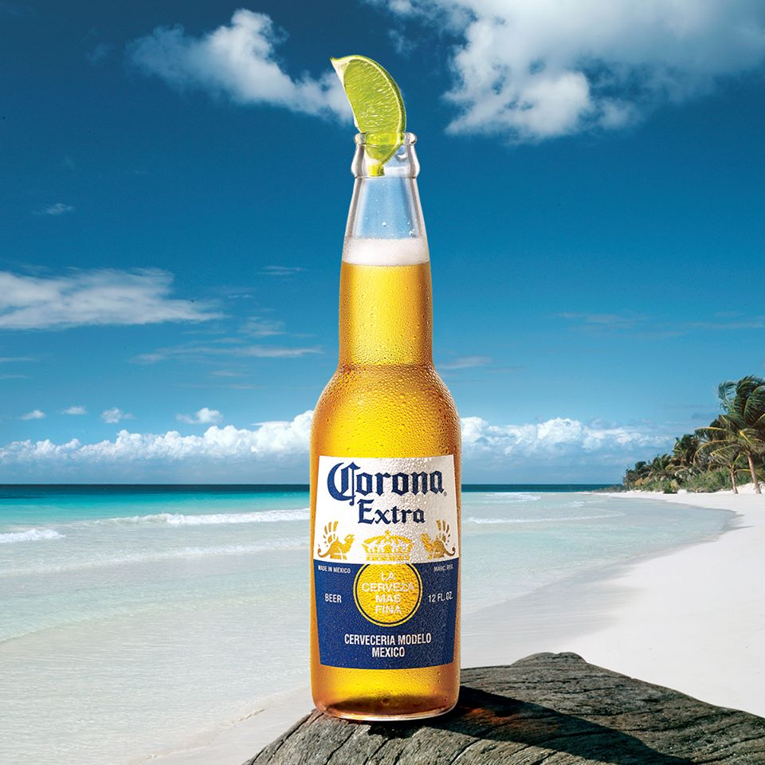
Brand Feelings (1 of 2)
Customers’ emotional responses and reactions to a brand
Brand feelings relate to the social currency evoked by the brand
Notes:
Brand feelings are
Transformational advertising: feeling on the beach

Slide 31
Brand Feelings (2 of 2)
Six important types of brand-building feelings:
Feelings can be:
Experiential and immediate, increasing in level of intensity
Warmth
Fun
Excitement
Private and enduring, increasing in level of gravity
Security
Social approval
Self-respect
Notes:
Important brand building feelings:
Warmth—Soothing feelings that make consumers feel a sense of calm or peacefulness. (e.g., Quaker oatmeal, Aunt Jemima pancake mix)
Fun—Upbeat feelings that make consumers feel amused, lighthearted, joyous, playful, and cheerful. (e. g Microsoft Xbox, Youtube)
Excitement—Ability of the brand to make consumers feel energized and experience something special. (e.g., e.g., Redbull)
Security—Ability of a brand to produce a feeling of safety, comfort, and self-assurance. (e.g., Allstate, Nationwide).
Social approval—Gives consumers a belief that others look favorably on their appearance and behavior. (e.g, Cadillac to an older generation)
Self-respect—Brand makes consumers feel better about themselves. (Tide – “doing the best things for the family”)
The first three types of feelings are experiential and immediate, increasing in level of intensity.

Slide 32
Brand Resonance (1 of 3)
Ultimate relationship and level of identification that a customer has with a brand:
Describes the nature of the relationship
Extent to which customers feel in sync with the brand
Characterized in terms of
Intensity: Depth of the psychological bond that customers have with a brand
Activity: engendered by loyalty (e.g., repeat purchase)
Four categories of brand resonance:
Behavioral loyalty
Attitudinal attachment
Sense of community
Active engagement
Notes:
Brand resonance is
e.g., (Harley –Davidson, Apple, Amazon).

Slide 33
Brand Resonance (2 of 3)
Behavioral loyalty:
Repeat purchases and the amount or share of category volume attributed to the brand:
Share of category requirements
Attitudinal attachment:
Resonance requires a strong personal attachment
Going beyond having a positive attitude:
Viewing the brand as something special
Notes:
Behavioral loyalty:
Gauged in terms of repeat purchases and the share of category volume attributed to the brand.
Attitudinal attachment:
Strong personal attachment with product.

Slide 34
Brand Resonance (3 of 3)
Sense of community:
Brand may take on a broader meaning by conveying a sense of community
Social phenomenon in which customers feel a kinship or affiliation with others associated with the brand
Active engagement:
Perhaps the strongest affirmation of brand loyalty
Willing to invest time, energy, money, or other resources beyond those expended during purchase or consumption
Notes:
Sense of community:
Sense of affiliation with other people associated with the brand.
Active engagement:
The strongest affirmation of brand loyalty occurs when customers are engaged, or willing to invest time, energy, money, or other resources in the brand beyond those expended during purchase or consumption of the brand.

Slide 35

MTV Case Study
This Photo by Unknown Author is licensed under CC BY-NC-ND
Notes:
40 mins

Slide 36
MTV Takeaways
First-mover advantage: False
Brand resonance: the culture center of Millennials and Generation X
Pitfall: American Culture export vs. Local culture.
This Photo by Unknown Author is licensed under CC BY-NC-ND

Slide 37
Group Discussion
Brand Exploratory
15 mins

Slide 38
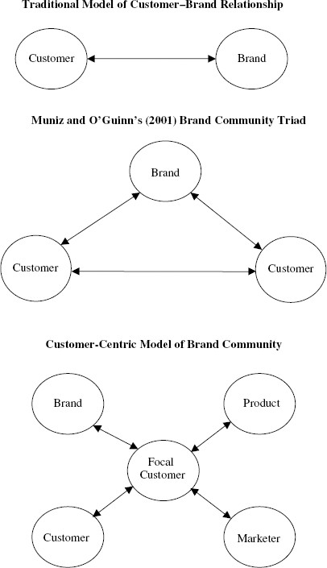
Journal Articles
Brand Community (Muniz & O’Guinn, 2001)
Consumer-brand dyad -> consumer-brand-consumer triad
Markers of community
Shared consciousness
Rituals and traditions
A sense of moral responsibility
Building Brand Community (McAlexander, Schouten, and Koenig, 2002)
Notes:
Consumer-brand dyad to consumer-brand-consumer triad
brands are social objects and socially constructed
Brand community greatly affects brand loyalty because it leads to brand commitment and hyper-loyalty.
Brand community has three markers of community:
* Shared consciousness: shared knowing of belonging
* Rituals and traditions
* A sense of moral responsibility
Building Brand Community

Slide 39
Brand-Building Implications
Marketers can assess their brand’s progress in their brand-building efforts through the brand resonance model:
Customers own the brand (missionaries)
Don’t take shortcuts with brands (step-by-step)
Brands should have a duality (head and heart)
Brands should have richness
Brand resonance provides important focus
Customer networks strengthen brand resonance
Notes:
See Figure 3-4 for details of each level of the model.

Slide 40
The Brand Value Chain
Structured approach to:
Assessing the sources and outcomes of brand equity and the manner by which marketing activities create brand value

Slide 41
Figure 3-5: Brand Value Chain
Notes:
Brand value chain—Implications:
Value creation begins with the marketing program investment.
Value creation requires more than the initial marketing investment.
Provides a detailed road map for tracking value creation that can make marketing research and intelligence efforts easier.

Slide 42
The Brand Value Stages (1 of 6)
Marketing program investment:
Any marketing program investment that can contribute to brand value development:
Intentional or not
Program quality multiplier:
D R I V E:
Distinctiveness
Relevance
Integrated
Value
Excellence

Slide 43
The Brand Value Stages (2 of 6)
Customer mind-set:
Includes everything that exists in the minds of customers with respect to brand:
Brand awareness
Brand associations
Brand attitudes
Brand attachment
Brand activity

Slide 44
The Brand Value Stages (3 of 6)
Marketplace conditions multiplier:
Extent to which value created depends on factors beyond the individual customer:
Competitive superiority
Channel and other intermediary support
Customer size and profile

Slide 45
The Brand Value Stages (4 of 6)
Market performance:
Price premiums
Price elasticities
Market share
Brand expansion
Cost structure; reduced marketing program expenditures
Brand profitability

Slide 46
The Brand Value Stages (5 of 6)
Investor sentiment multiplier:
Financial analysts and investors arrive at their brand valuations and investment decisions through the following:
Market dynamics
Growth potential
Risk profile
Brand contribution
Shareholder value:
Financial marketplace formulates opinions and assessments
Direct financial implications for brand value

Slide 47
The Brand Value Stages (6 of 6)
The brand value chain has numerous implications:
Value creation begins with the marketing program investment
Value creation requires more than an initial marketing investment
Band value chain provides a detailed road map for tracking value creation

Slide 48

Brand Community
This Photo by Unknown Author is licensed under CC BY-NC
Notes:
Airbnb’s consistent rebrand focuses on the sense of belonging to a community | The Branding Journal
Airbnb’s consistent rebrand focuses on the sense of belonging to a community | The Branding Journal

